Slide 1
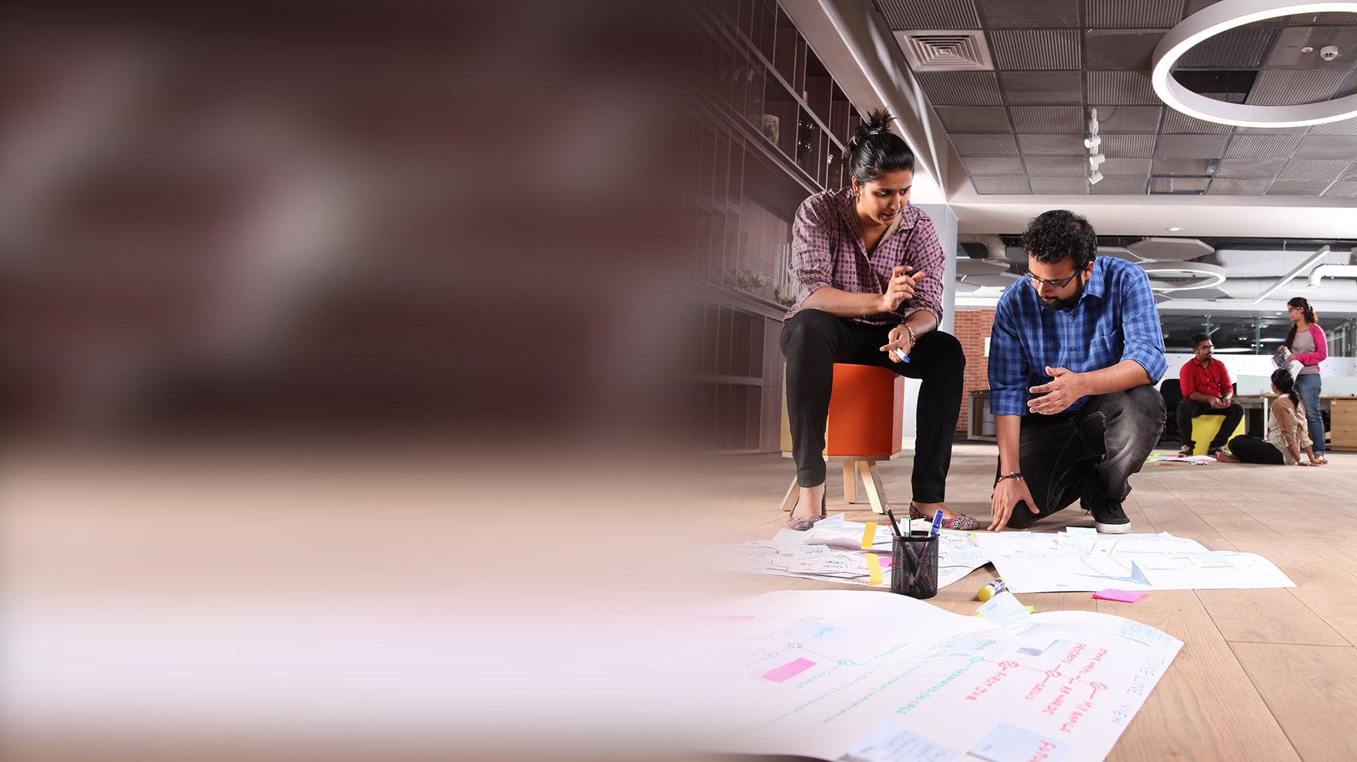


Docker and Kubernetes Use Cases
Presented by:
Infosys Continuous Testing CoE

Slide 2
Use Cases
Cost Effectiveness
Migration with minimum resources and time
Effective implementation with small team in minimum time
Zero Downtime and less test failures

Slide 3
Use Cases

Slide 4
Cost effectiveness
Scenario 1 : We have to host 100 applications to run in different environment.
Challenges:
To setup 100 applications, we have to configure 50 servers in daytime and 1 server in night time as per traffic or test case.
Which includes different machines for QA, staging and deployment team.
Hence, we have to pay for -
50 servers
Orchestration/Load balancer.
Problem Solving :
It involves only 5-6 servers cost for applications, as many container for different environment can be spin up within a server.
Orchestration of server & container is done automatically by kubernetes. Hence, load balancer cost is neglected.
We can spin 1 container at night and 5 container at day time.
So we need to pay for 5-6 server cost only.
Traditional | Docker Kuberenetes
Pay for 50 servers | Pay for only 5-6 server
Load Balancing | No cost

Slide 5
Migration with minimum resources and time.
Scenario 2 : Team have to migrate from 5 windows server to Linux servers.
Challenges:
Need to consider OS version & machine configuration and environment variables for new servers.
Need to make changes in configuration script like ansible, chef, puppet to create the testing environment such as OS and the application dependencies(like Java, maven, etc.) in each VM which takes more time .
Migration and deployment of new servers will take more time and resources.
Problem Solving:
In docker, we will pull images and are ready to run in new servers in fraction of seconds.
Less time and resources needed. Multiple version of applications can be setup in one machine efficiently.
Docker image is already packaged with its dependencies. Hence, we can use those images and spin up the container needed for testing application in a server independent of its OS.
Traditional | Docker Kuberenetes
Depends on OS compatibility | No OS dependency
Configuration and deployment efforts | No changes
More resources and Time | Limit resource consumption. Run on new servers in fraction of seconds

Slide 6
Zero Environment Downtime and less test failures.
Scenario 3 : 5000+ test cases executed overnight takes around 13 hours in static VMs.
Challenges :
5000+ test cases executed overnight takes around 13 hours..
Application and environment are not stable and face challenges while running all test cases which fails sometimes.
If any VM fails, then test cases will not get executed and re-execution of test scripts needed.
Problem Solving:
Kubernetes will make sure that application/test cases is always running as it has self healing feature. Hence, no test execution failures because of downtime.
Traditional | Docker Kubernetes
Static VMs | Orchestrated Containers
Test execution failures with Environment downtime | No test execution failures - zero downtime

Slide 7
Effective implementation with small team in minimum time
Scenario 4: Configure environment for testing applications with selenium grid in VMs.
Challenges :
Team has to work on configuration from scratch for particular component setup
Tightly coupled applications and for new changes need to execute whole environment setup.
Problem Solving:
Decoupled applications with clear separation of roles.
Reusability of already developed components.
Multiple version of application can run in one VM.
Small team is enough as fault tolerance is handled.
No need to worry about the version of the programming language, dependencies management, database version, or server configuration since all of that is unified in Docker.

Slide 8

Thank You

